Slide 1
M.A. psychology
III sem.
Paper 2nd ,UNIT-1
Psychological testing
Dr. Kiran Bala Verma
Associate Professor & Head
Department of Psychology
Harishchandra P.G. College, Varanasi

Slide 2
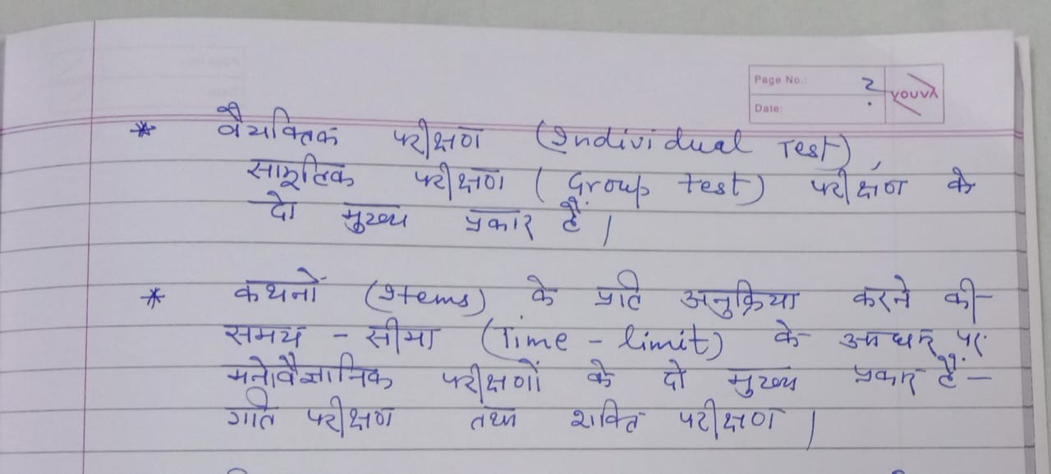

Slide 3
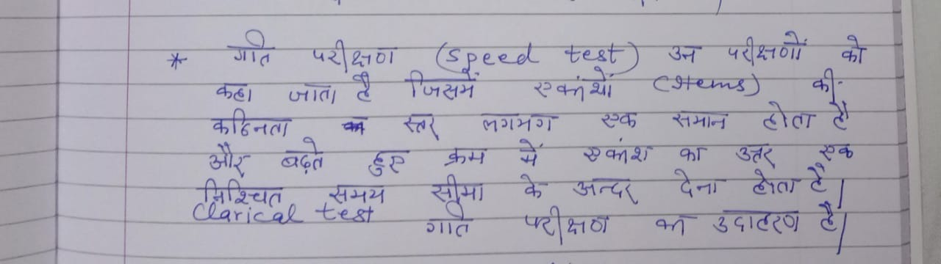

Slide 4
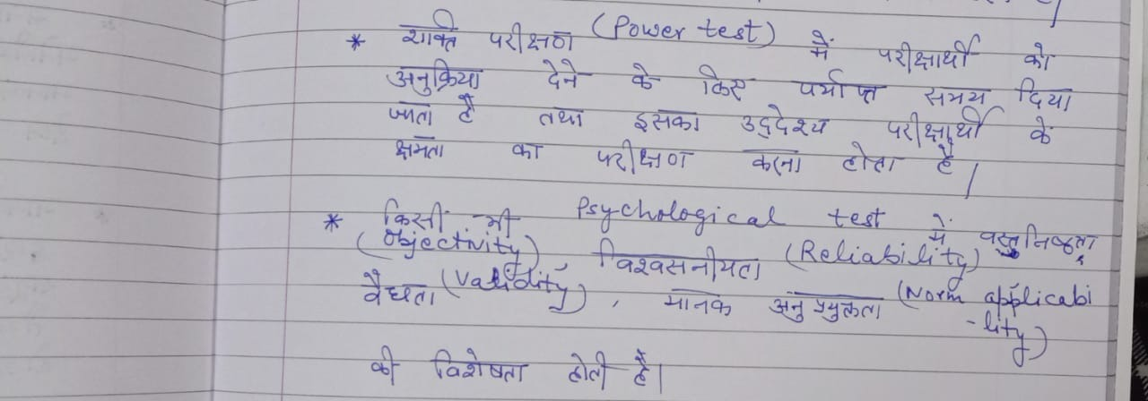

Slide 5
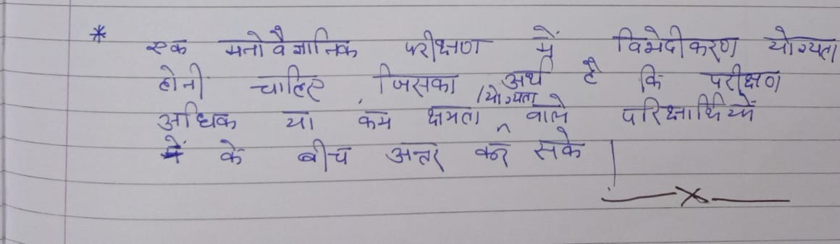

Slide 6
THANK YOU

