Slide 1

M.A. psychology
III sem.
Paper 2^{nd ,UNIT-1}
Psychological testing
Dr. Kiran Bala Verma
Associate Professor & Head
Department of Psychology
Harishchandra P.G. College, Varanasi

Slide 2
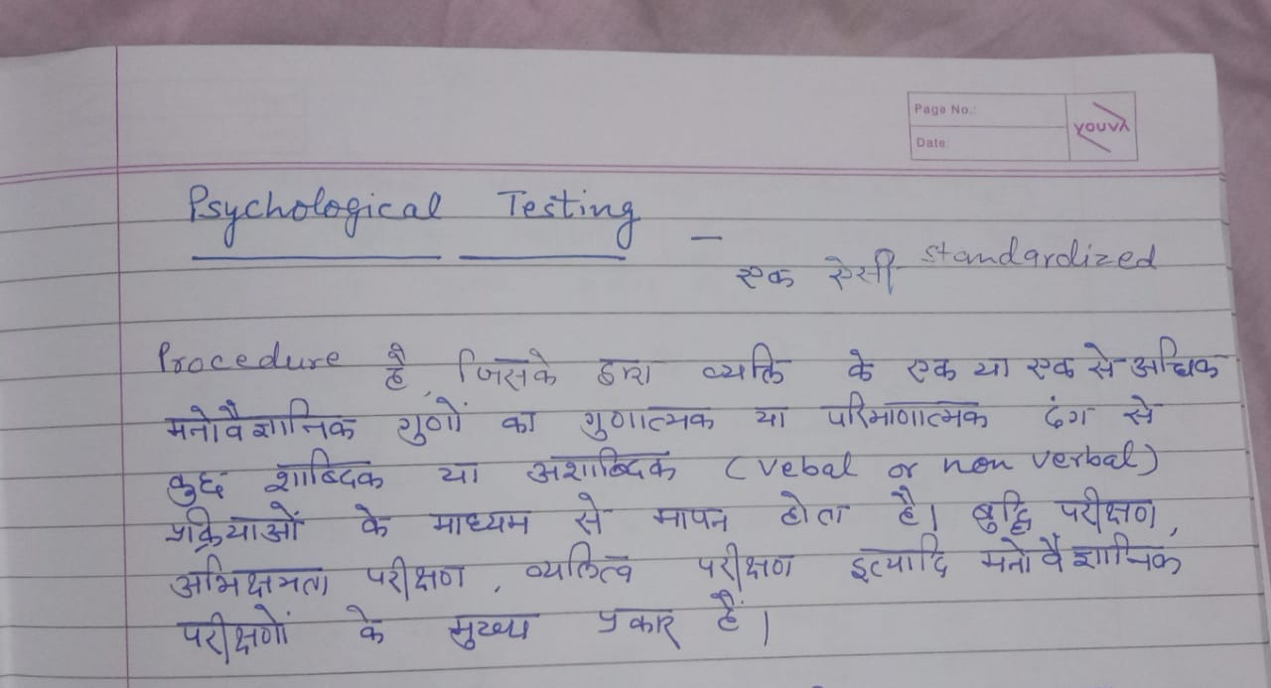

Slide 3
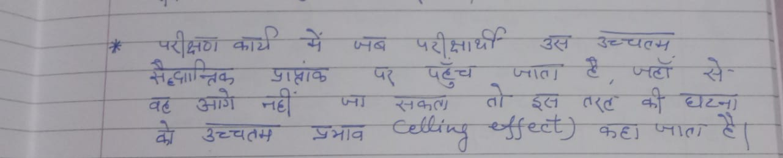
(

Slide 4
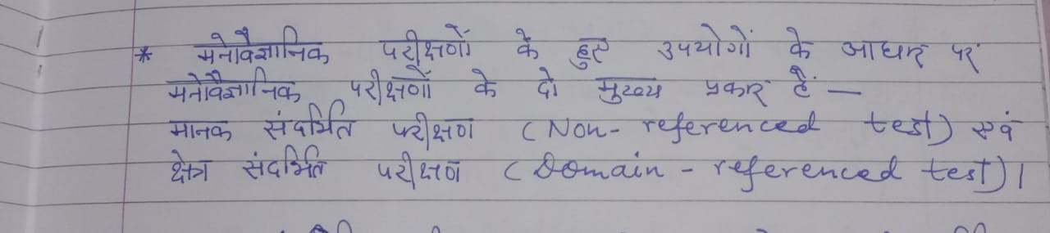
Types of PSYCHOLOGICAL TESTING :
1.

Slide 5
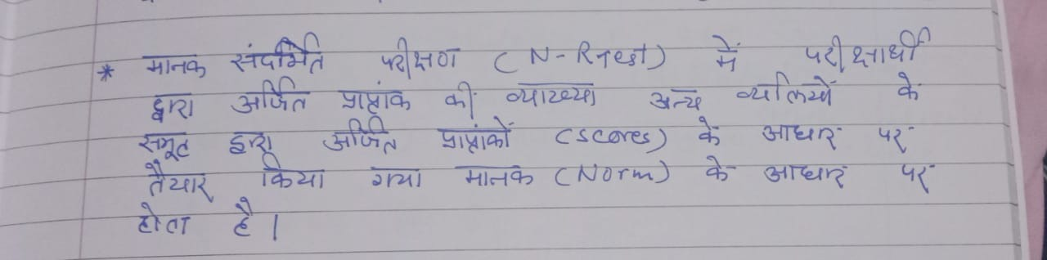
2.

Slide 6
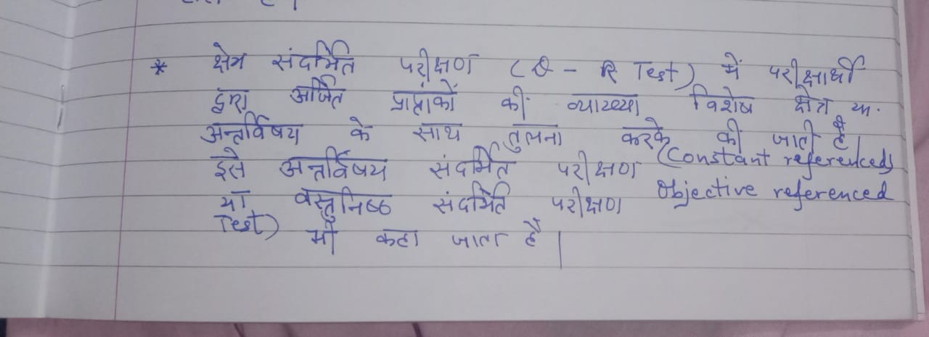
3.

Slide 7
Thank You

